Slide 1

Spotify Data Analysis Dashboard
Exploring music trends, track popularity, and genre insights through comprehensive data visualization and analytics.

Slide 2

Dashboard Overview
Key Metrics
Data Insights
Our comprehensive dashboard tracks essential Spotify metrics including track duration, popularity scores, explicit content distribution, and genre performance across the platform.
Visual analytics reveal patterns in listener preferences, helping identify trends in music consumption and artist performance across different categories.

Slide 3
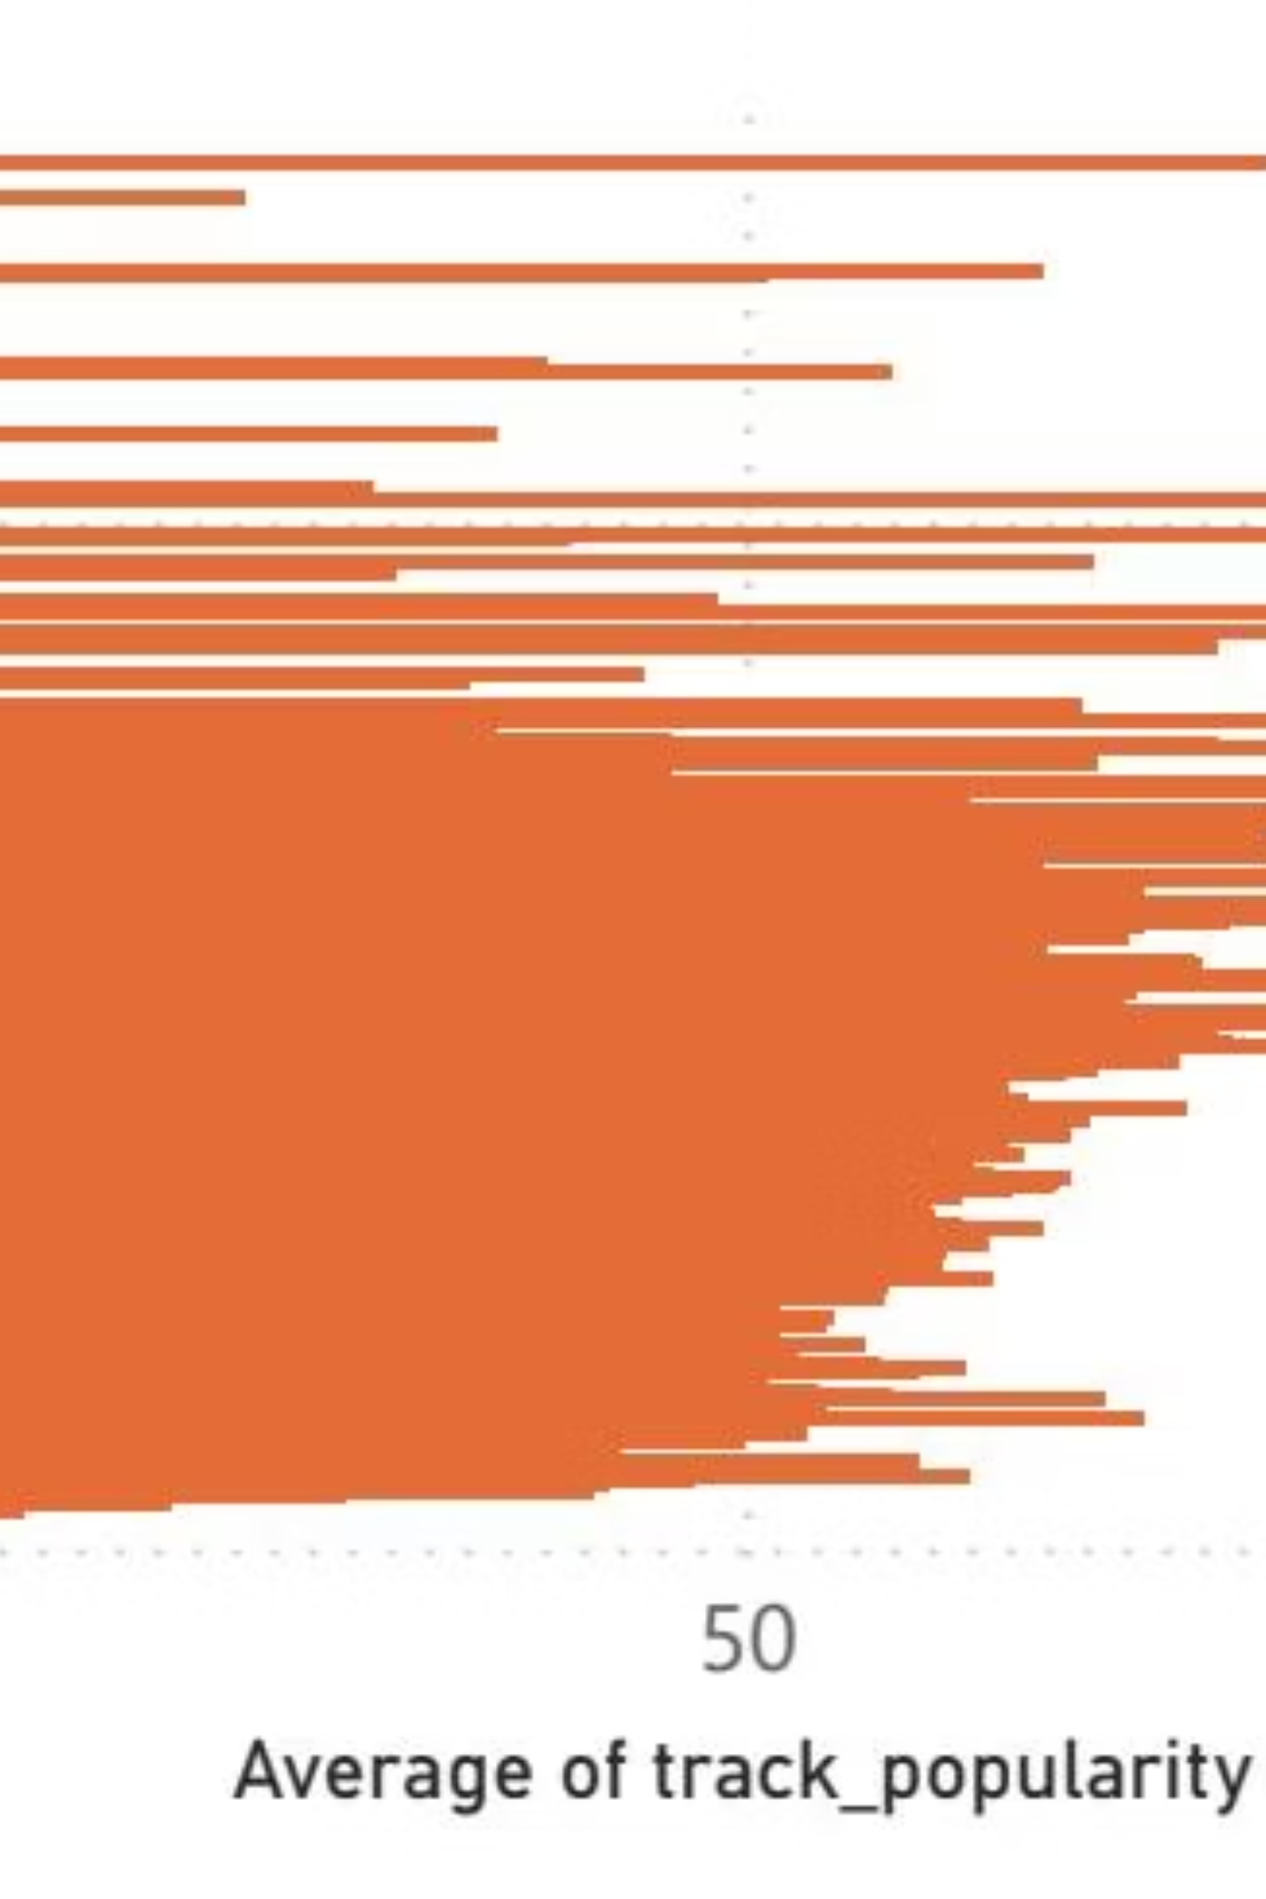
Track Duration Analysis
Duration Trends
Listener Preferences
Analysis reveals how track length correlates with popularity across different genres and time periods.
Data shows optimal track lengths that maximize engagement and streaming completion rates.
Platform Patterns
Understanding duration preferences helps artists optimize content for maximum reach and retention.

Slide 4
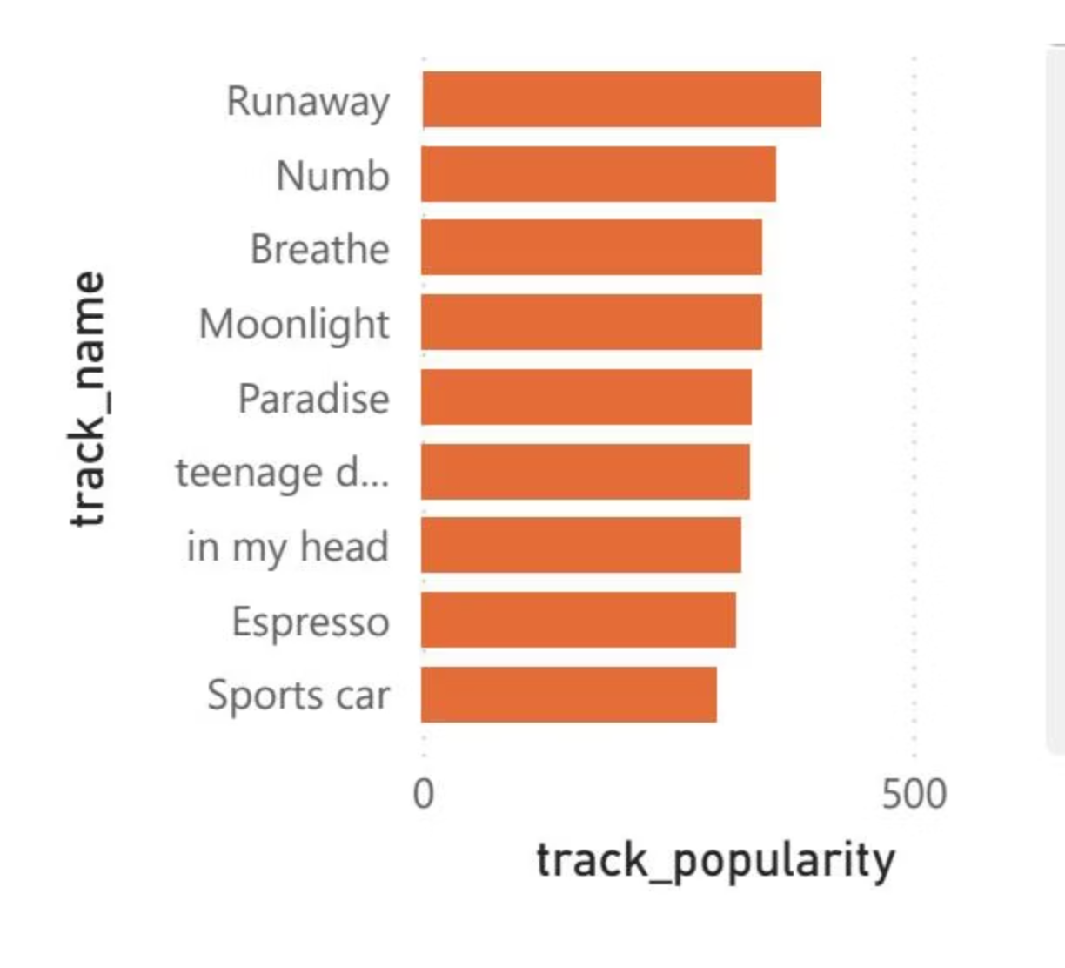
Track Popularity Metrics
Popularity Distribution
Comprehensive analysis of track performance reveals patterns in what makes songs successful on the platform.
Streaming volume patterns
Engagement metrics
Viral growth indicators
Playlist placement impact

Slide 5
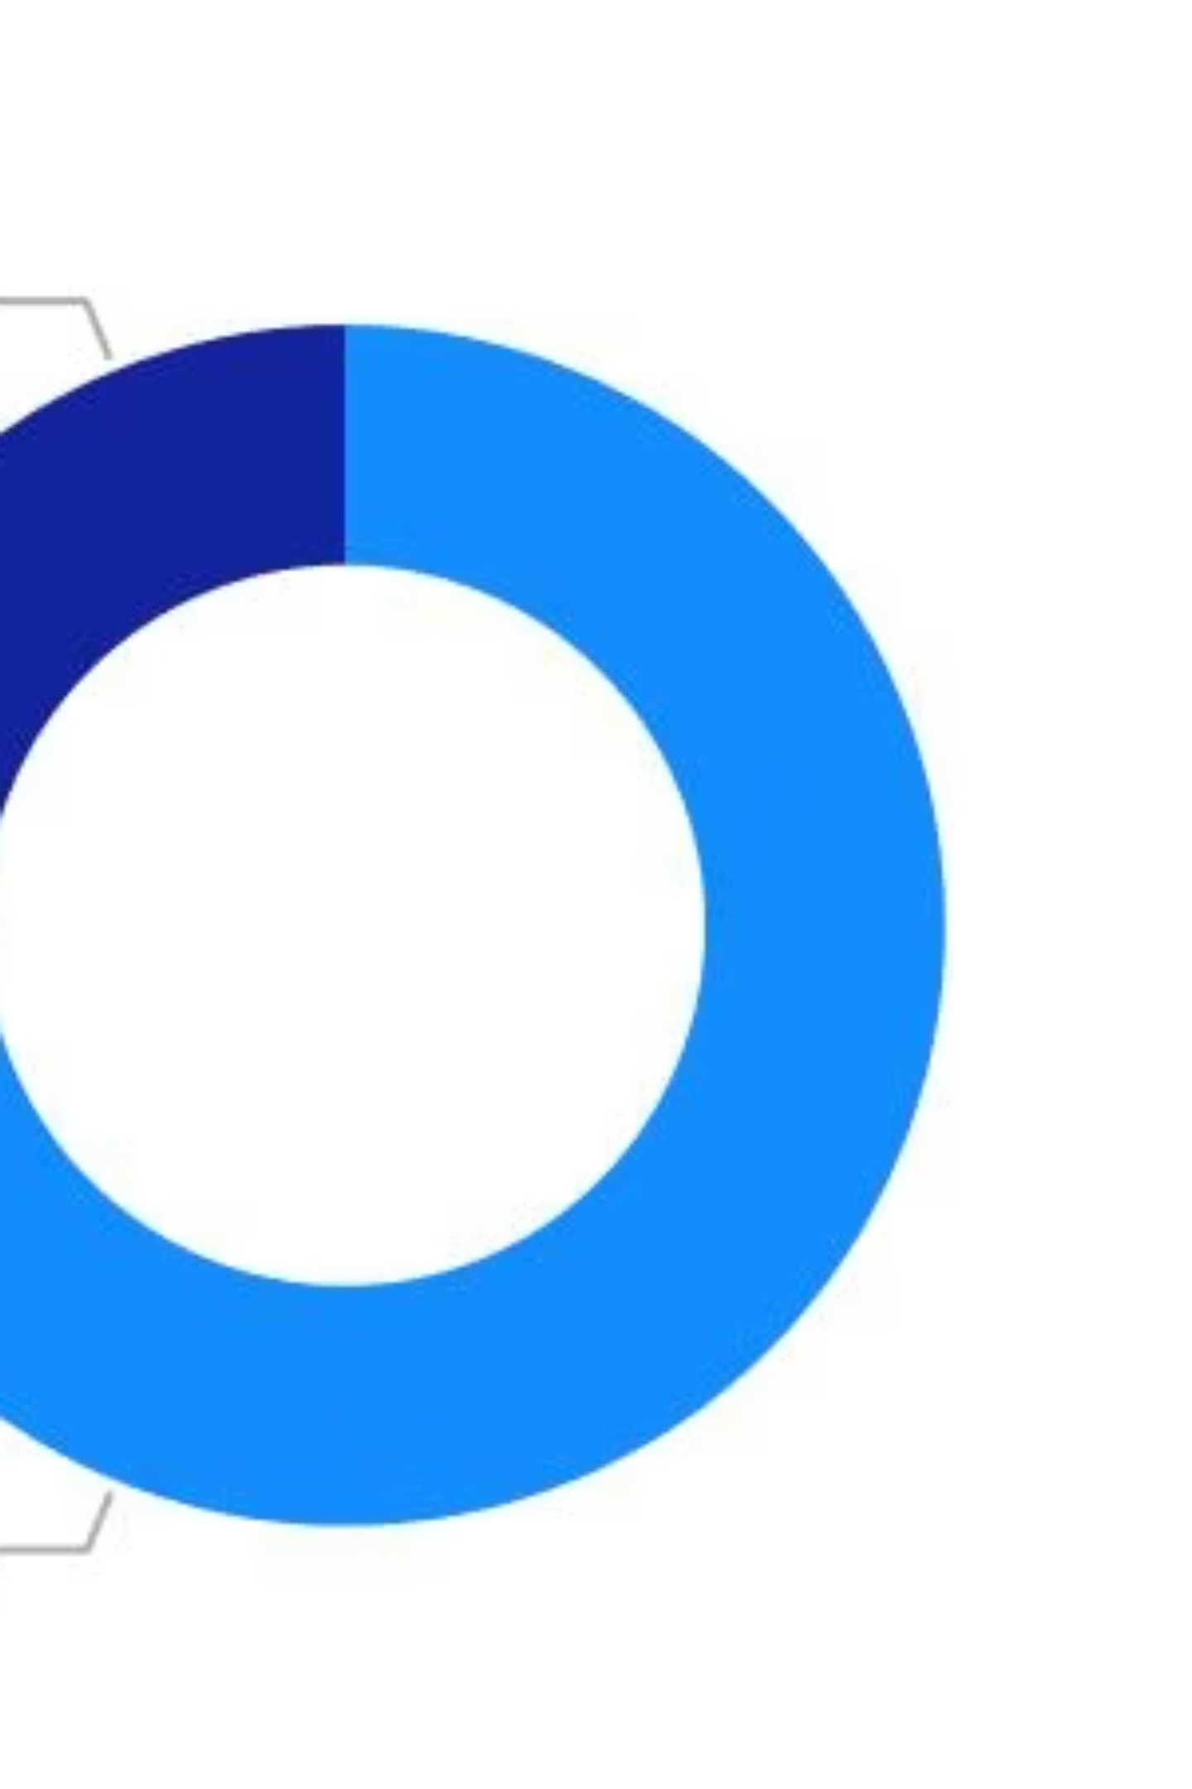
Explicit Content Analysis
Content Distribution
Tracking the ratio of explicit versus clean content across the platform and its impact on listener demographics.
Genre Correlation
Examining which genres have higher explicit content rates and how this affects overall popularity metrics.

Slide 6
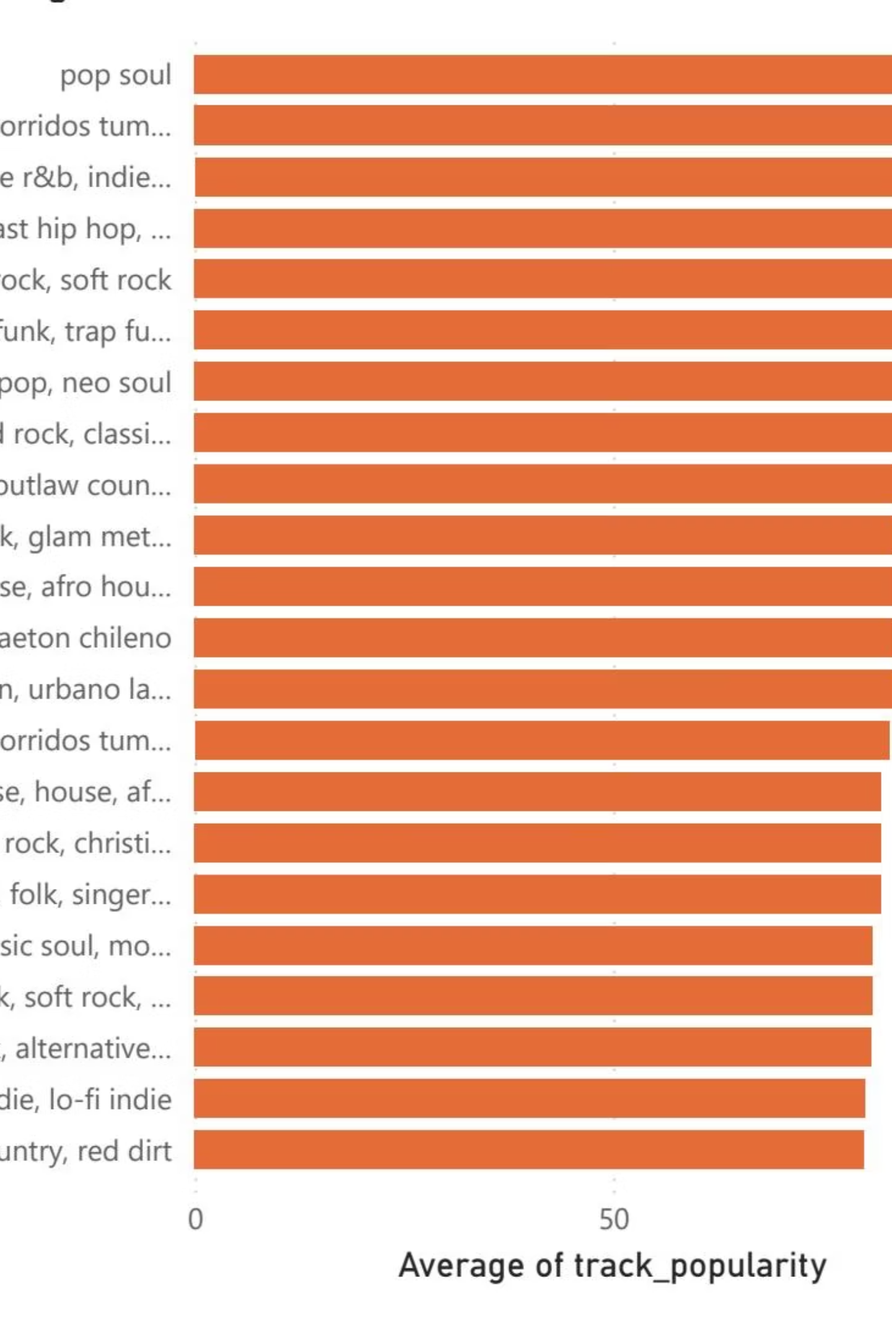
Most Popular Genres
Genre performance analysis reveals dominant music categories and emerging trends shaping the streaming landscape.

Slide 7


Genre Performance Breakdown
Top Performers
Leading genres dominate streaming numbers with consistent engagement across demographics and regions.
Emerging Trends
New genre categories show rapid growth, indicating shifting listener preferences and cultural influences.
Global Reach
Cross-cultural genre adoption demonstrates music's universal appeal and platform's international impact.

Slide 8
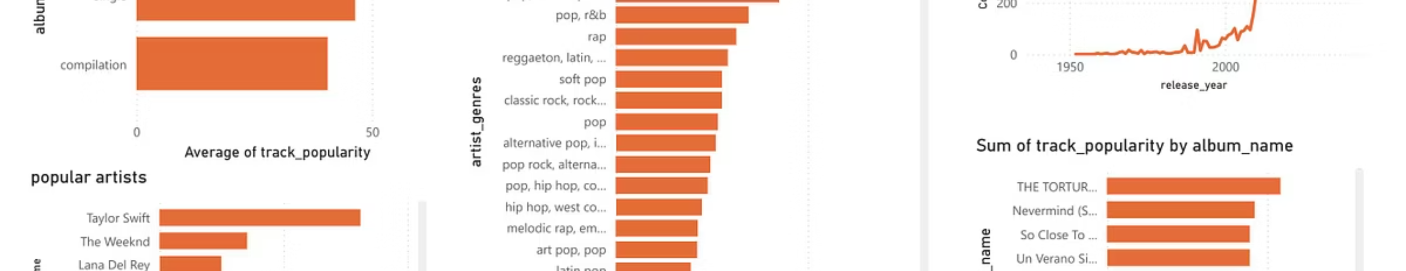
Advanced Analytics Dashboard
Real-Time Data
Predictive Analytics
Custom Reports
Live tracking of streaming metrics and performance indicators.
Forecasting trends based on historical patterns and current data.
Tailored insights for artists, labels, and industry stakeholders.

Slide 9
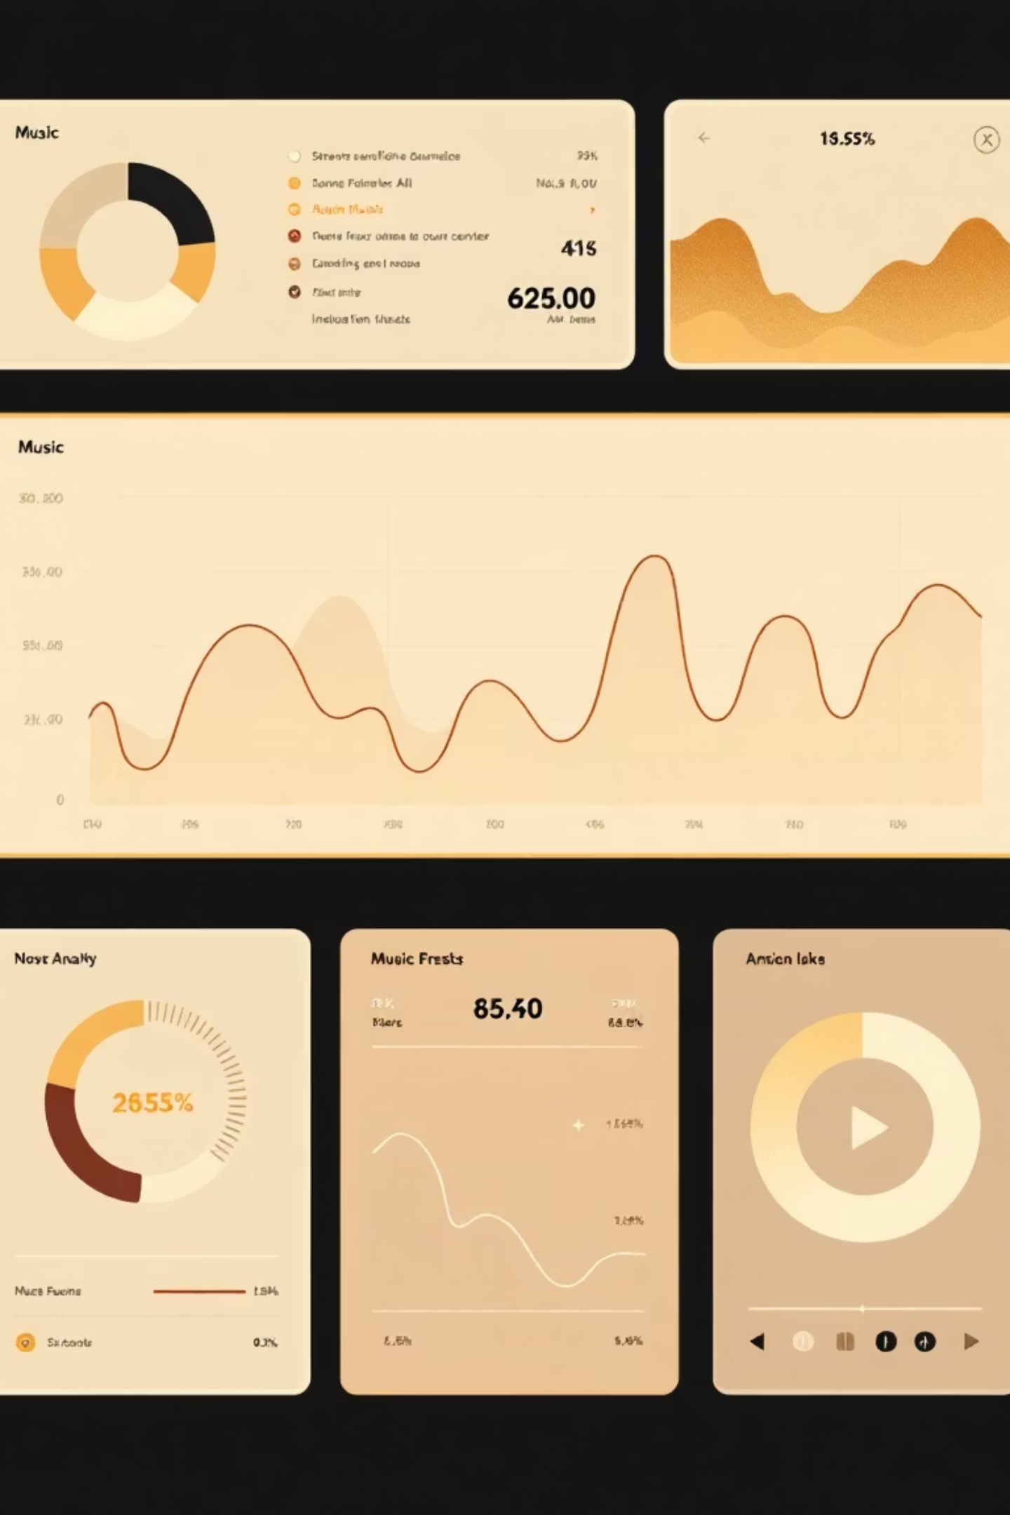
Key Insights & Findings
01
Duration Matters
Track length significantly impacts popularity, with optimal ranges varying by genre and audience.
02
Genre Dynamics
Popular genres show distinct patterns in explicit content, duration preferences, and engagement metrics.
03
Content Strategy
Data-driven insights enable artists to optimize releases for maximum platform performance and reach.
04
Market Evolution
Continuous monitoring reveals emerging trends and shifting listener behaviors across demographics.

Slide 10

Data-Driven Music Intelligence
Comprehensive analytics transforming how we understand and engage with music streaming trends, empowering artists and industry professionals with actionable insights.

